Slide 1
(Considerations) Render Queue
CGCII
Cho sanghyun’s Game Classes II
All Right Reserved ©SD Labs

Slide 2
 CONTENTS
CGCII
Cho sanghyun’s Game Classes II
Why does Render-Queue inherit IRenderer interface?
Render Queue with Spatial Queue
Light Culling
Design of RenderableNode
질문?
All Right Reserved ©SD Labs

Slide 3
 Why does Render Queue inherit IRenderer interface?
CGCII
Cho sanghyun’s Game Classes II
Render Queue는 왜???
(V) void ProcessRender ();
IRenderable
(V) void Render ();
IRenderer
왜!!
(V) void Render ();
CRendererMesh
(V) void Render ();
CRendererQueue
Render Queue는 왜 왜 왜!!! IRnderer를 상속받아 구현했을까???
All Right Reserved ©SD Labs

Slide 4
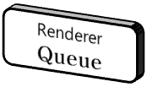
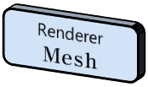
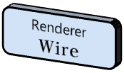
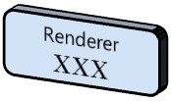




 Render Queue
CGCII
Cho sanghyun’s Game Classes II
Render Queue는 왜???
이렇게 다중 Render Queue의 구현을 위해서!!!
필요하다!!!
결론적으로 이렇게 Hierarchy구조를 형성하게 된다!
이건 또 왜!!
All Right Reserved ©SD Labs

Slide 5







 Render Queue with Spartial structure
CGCII
Cho sanghyun’s Game Classes II
E
F
A
B
A1
A2
B
B1
C
B2
A
B
C
D
A
A
C
A3
H
A4
B3
B4
D
E
C
F
D
C1
C2
D1
D2
A1
A2
A3
A4
B1
B2
B3
B4
C1
C2
C3
C4
D1
D2
D3
D4
B
D
G
C3
C4
G
D3
D4
H
All Right Reserved ©SD Labs

Slide 6


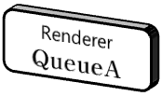
 Spartial structure에서
CGCII
Cho sanghyun’s Game Classes II
Renderer
Queue
E
F
A
B
C
D
A
Renderer
Queue
Renderer
Queue
C
A1
A2
A3
A4
B1
B2
B3
B4
C1
C2
C3
C4
D1
D2
D3
D4
Renderer
Queue
Renderer
Queue
Renderer
Queue
B
D
G
H
이렇게 통째로 Queueing이 가능하다.
All Right Reserved ©SD Labs

Slide 7
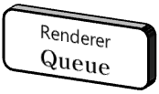



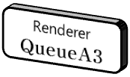
 Light-Culling
CGCII
Cho sanghyun’s Game Classes II
View Frustum culling
A
B
A
L1
B
C
H
Light Culling (L1)
D
L2
E
C
F
D
G
D3
Light Culling (L2)
All Right Reserved ©SD Labs

Slide 8
CGCII
Cho sanghyun’s Game Classes II
■ Design of RenderableNode
(V) void Render ();
IRenderer
Node의 Renderer는 기본적으로 여기에 모두 붙어 있다!!!!
(V) void ProcessRender ();
IRenderable
(V) void Render ();
CRendererQueue
(V) void Render ();
CRenderableNode
All Right Reserved ©SD Labs

Slide 9
☑ 질문?
CGCII
Cho sanghyun’s Game Classes II
All Right Reserved ©SD Labs

